Slide 1

AI Ninja Series – Day 2

Slide 2

Day 2

Slide 3
Re-Cap of Day 1 + Challenge Queries

Slide 4
Vision| Face
The Azure Face API is a cognitive service that provides algorithms for detecting, recognizing, and analyzing human faces in images. The ability to process human face information is important in many different software scenarios, such as security, natural user interface, image content analysis and management, mobile apps, and robotics.
Few concepts:
Face Detection/Tracking:
Detecting a face but not knowing its identity
Can detect emotions, gender, age, etc.,
Face Recognition/Identification
Identifying a specified face
.

Slide 5
Vision| Face
The following are the mostly used APIs
Face Detection – Detect one or more faces in an image and returns the face rectangle along with face attributes like – Age, Gender, Pose, Smile and Facial Hair along with 27 landmarks for each face.
Face Identification - Face API enables you to search, identify and match faces in your private repository of up to 1 million people.
Face Verification - Check the likelihood that two faces belong to the same person. The API will return a confidence score about how likely it is that the two faces belong to one person.
Fdgdf
dfdfg
Similar Face Search - Easily find similar-looking faces. Given a collection of faces and a new face as a query, this API will return a collection of similar faces.
Face Grouping – Organize many unidentified faces together into Groups based on their visual similarity
.

Slide 6
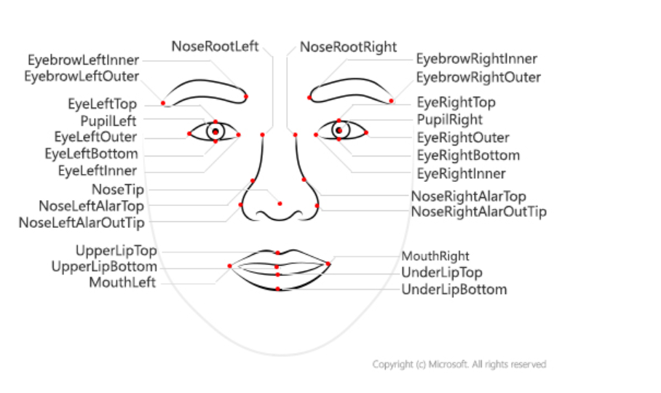
Vision| FACE API
Face Landmarks
.

Slide 7
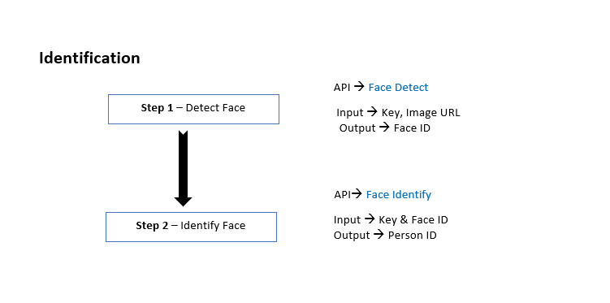
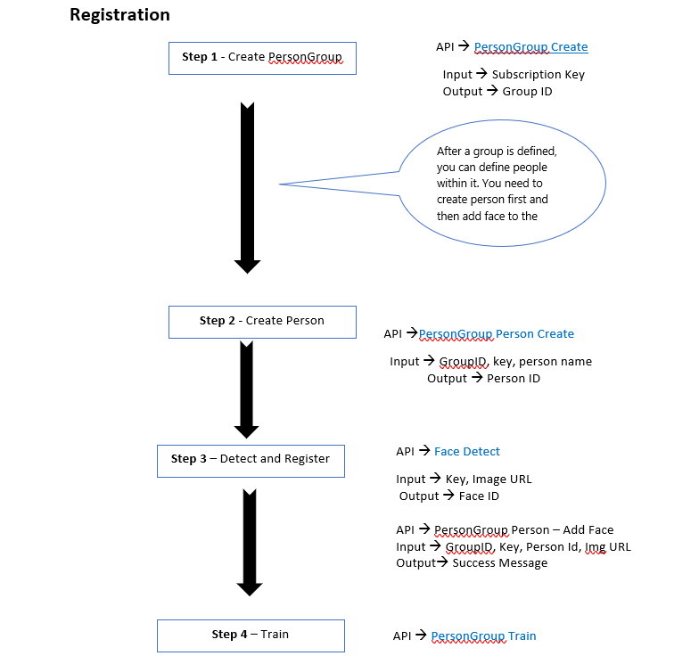

Slide 8
Vision| Face
Flow of APIs for Facial Verification / Recognition
Developer Portal
https://westcentralus.dev.cognitive.microsoft.com/docs/services/563879b61984550e40cbbe8d/operations/563879b61984550f30395237/console
.

Slide 9
Vision| Face API
.
DEMO
.

Slide 10
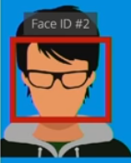
Vision| Face
Web API calls for 1 Person
Detect – Return a face ID
Identify – return a user ID
Get Person – return the user data
That’s 3 API call = 3 Transaction
.
Face#1
Web API calls for 3 Person
Detect – 1 API call , 1 transaction up to 64 faces
Identify – 1 API call , 1 transaction up to 10 faces
Get Person – 3 API calls , 3 transactions
That’s 5 API call = 5 Transaction
Offline face detection frameworks – Find a face before sending it to Cognitive Service
.
Face#1
Face#2
Face#3

Slide 11
Vision| FACE API
Image Requirements / Limitations / Challenges
.
Avoid Obstructions blocking one or both eyes – Hands Blocking Eyes or Wearing Sun Glasses
Avoid Harsh lighting – Flashing lights or Severe lights in the background
Extreme face angles (head pose) or face occlusion (objects such as sunglasses or hands that block part of the face) can affect detection. Frontal and near-frontal faces give the best results.
Avoid using very old photos for training.
Avoid extreme facial expression during Training… Like Laughing out Aloud or Screaming etc. PCA fails to handle extreme emotions in similar faces
Train the images formats of types PNG, JPG, GIF or BMP. Other formats are not allowed
Avoid uploading image files which are beyond 4 MB size. Max size for a Training image is 4 MB
The detectable face size range is 36x36 to 4096x4096 pixels. Faces out of this range will not be detected. Optimal Face Size to consider for Training is 200x200 pixels
Make sure face image used for training is having around 100 pixels between the two eyes

Slide 12
Vision| FACE API
Building Blocks
.
Device Validation: Device Infra requirements validation – Camera Pixel Size, OS Minimum Version as per the Face Recognition Guidelines
Object Filtering: Removal of Objects that reduces the Accuracy of Face Detection – Removal of Flashy Lights in the back-ground, Removal of Sun Glasses, Avoiding Images with Darkness
Image Validation : Validates the Image with respect to FACE Recognition Guidelines – Face Availability, Face Visibility, More number of Faces, Face Image Guidelines ( Min Pixel, Max Pixel, Optimal Pixes, Pixel Distance Between Eyes), Face Angle and Head Orientation
Fake / Real Image Detection : One of the biggest Security problem with Facial recognition systems is to identify whether the “Face” being used for registration / verification is for real or fake. We do not have any APIs or Model to check Real Vs Fake. WE have build our own model to identify “Real Vs Fake” and see the demo for the same - Link
Additional Layer of Liveliness Detection using Gestures : It is always a best practice to ask the user to show some gestures before verification just to make sure liveliness of the user is always checked. Generally gestures like “Smile”, “Eye Blinking”
Are used to check the liveliness of the user.

Slide 13
Vision| Face API
Use Cases
.
Facial Recognition Based Attendance Systems
Facial Recognition Based Access Control System
Tesla car company in electric-car market, showed-off an SUV that’s hoping to sell in 2019 that unlocks the door when its facial recognition software recognizes the driver.
Safety in Cars - A Face enabled system monitors eye blinking, facial expressions and head movements. If any signs are obtained of the driver being drowsy or inattentive, the biometric system sends some visual or audible alerts to get back the driver’s attention.
Airlines(JetBlue) have already started using face recognition to help people check bags, check into flights and board planes faster. Passengers will step up to a camera, and the kiosk will compare the facial scan to passport photos in the U.S. customs database to confirm the match.
A variety of phones including the latest iPhone X, OnePlus 5T are now using face recognition to unlock phones.
Retail Crime - Face recognition is currently being used to instantly identify when known shoplifters, organized retail criminals or people with a history of fraud enter retail establishments. Photographs of individuals can be matched against large databases of criminals so that loss prevention and retail security professionals can be instantly notified

Slide 14
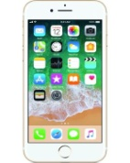
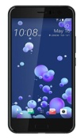
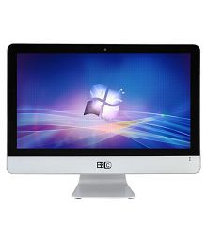


Device Validation
No
Show Notification to User & Retry
Channels
Yes
Image Validation
No
Show Notification to User & Retry
Yes
Object Filtering
No
Show Notification to User & Retry
Face Captured
Yes
Fake or Real Image Checking ?
Yes
No
Liveliness Detection Using Gesture
Show the Gesture
Show Notification to User & Retry
Yes
Registration / Verification Done Successfully
Valid Gesture ?
Show Notification to
User to follow Gesture
No

Slide 15
Speech| Speech Services
Enabling Ears to your app or service. Convert spoken language into text or produce natural sounding speech from text using standard (or customizable) voice fonts.
Speech to Text – Converts spoken audio to text for intuitive interaction
https://azure.microsoft.com/en-in/services/cognitive-services/speech-to-text/
2. Text to Speech – Give natural voice to your apps
https://azure.microsoft.com/en-in/services/cognitive-services/text-to-speech/
3. Speech Translation

Slide 16
Speech| Speech Services
Demos
.

Slide 17
Speech| Speaker Recognition
1. Speech Verification – Use your voice for verification. The API can be used to power applications with an intelligent verification tool. If the speaker claims to be of a certain identity use voice to verify this claim.
2. Speaker Identification –Identifies who is speaking. The API can be used to determine the identity of an unknown speaker. Input audio of the unknown speaker is paired against a group of selected speakers, and in the case there is a match found, the speaker’s identity is returned.
https://azure.microsoft.com/en-in/services/cognitive-services/speaker-recognition/

Slide 18
Speech| Speaker Identification
Flow of APIs
Create Identification Profile
Create Identification Enrollment
Speaker Identification
https://westus.dev.cognitive.microsoft.com/docs/services/563309b6778daf02acc0a508/operations/5645c3271984551c84ec6797
.

Slide 19
Speech| Speaker Verification
Flow of APIs
Create Verification Profile
Create Verification Enrollment
Enrollment can happen only with predefined phrases. This list can be seen by calling the API Verification Phrases
For Verification, we need to do Enrollment of the same Phrase for 3 times with states - Enrolling, Training, Enrolled
3. Speaker Verification
https://westus.dev.cognitive.microsoft.com/docs/services/563309b6778daf02acc0a508/operations/5645c3271984551c84ec6797
.

Slide 20
Speech| Speaker Recognition
Demos
.

Slide 21
Speech|Usecases
Use Cases
.
Building Voice Command Based Applications
Generating Conversation Transcript
Call center Log Analytics and Scoring of DSAT , CSAT

Slide 22
Speech
Audio Requirements / Limitations / Challenges
.
Audio Files for Speaker Verification and Identification should meeting the following requirements
Use this as Step Up Authentication and not as the Primary Authentication Mechanism.
Container | WAV
Encoding | PCM
Rate | 16K
Sample Format | 16 bit
Channels | Mono

Slide 23
Language| QnA Maker
Create an FAQ service from existing content
.
Knowledge Base out of semi-structured content like FAQ documents, URLs, and product manuals and answers natural language questions by matching it with the best possible answer from the QnA’s in your Knowledge base.
https://www.qnamaker.ai
QnA Maker Life Cycle
Step 1: Create a QnA Maker resource in the Azure portal.
Step 2: Create a knowledge base in the QnA Maker portal. Add files and URLs to create the knowledge base.
Step 3: Publish your knowledge base and test from your custom endpoint using cURL or Postman.
Step 4: From your client application, programmatically call your knowledge base's endpoint. The client application processes the JSON response to show the best answer to the user.

Slide 24
Language | Text Analytics
The Text Analytics API is a cloud-based service that provides advanced natural language processing over raw text, and includes four main functions: sentiment analysis, key phrase extraction, language detection, and entity recognition.
Sentiment Analysis - Sentiment Analysis tells whether the given phrase is positive or Negative. The Api returns values between 0 to 1 . If the value is close to 1 it indicates the phrase is positive, if it close to 0 it indicate the phrase is negative.
Key Phrase Extraction - Helps you in identifying all Key words available in the phrase. the document is bigger. Document size must be under 5,120 characters per document, and you. This works better when can have up to 1,000 items (IDs) per collection.
Language Detection- You can detect which language the input text is written in and report a single language code for every document submitted on the request for up to 120 languages.
NER(Named Entity Recognition) is the ability of Text Analytics which identifies the Entities available in the phrase
.

Slide 25
Language| Text Analytics
API Request and Response
https://azure.microsoft.com/en-in/services/cognitive-services/text-analytics/
Demos
.

Slide 26
Language| Text Analytics
Use Cases
.
Product / Any Entity Text Based Feedback Sentiments
Building out Data Pipelines that automatically extracts data from multiple sources
Building out Knowledge Mining Use cases

Slide 27
Language| Content Moderation
The Azure Content Moderator API is a cognitive service that checks text, image, and video content for material that is potentially offensive, risky, or otherwise undesirable. When such material is found, the service applies appropriate labels (flags) to the content
Text Moderation- Scans text for offensive content, sexually explicit or suggestive content, profanity, and personal data.
Image Moderation - Scans images for adult or racy content, detects text in images with the Optical Character Recognition (OCR) capability, and detects faces.
Video Moderation - Scans videos for adult or racy content and returns time markers for said content.
.

Slide 28
Language| Content Moderation
Use Cases
.
Online marketplaces that moderate product catalogs and other user-generated content
Gaming companies that moderate user-generated game artifacts and chat rooms
Social messaging platforms that moderate images, text, and videos added by their users
Enterprise media companies that implement centralized moderation for their content

Slide 29
Cognitive Services | Decision Making – Anomaly Detection
The Anomaly Detector API enables you to monitor and detect abnormalities in your time series data with machine learning. The Anomaly Detector API adapts by automatically identifying and applying the best-fitting models to your data, regardless of industry, scenario, or data volume
Batch detection- To detect anomalies throughout a batch of data points over a given time range, use the following request URI with your time series data:
/timeseries/entire/detect.
Streaming detection- To continuously detect anomalies on streaming data, use the following request URI with your latest data point:
/timeseries/last/detect.
.

Slide 30
Cognitive Services | Decision Making – Anomaly Detection - Demo
.

Slide 31
Cognitive Services | Decision Making – Anomaly Detection
Use Cases
.
Outlier Detection in any Industry segments

Slide 32
Cognitive Services | Decision Making – Personalizer
Azure Personalizer is a cloud-based API service that allows you to choose the best experience to show to your users, learning from their real-time behavior.
Client Application provides list o Actions and along Context (User / Device / Both)
Personalizer chooses the best action to take and responds bac the client application
Client Application takes that action and updates personalizer back with feedback inters of reward points
Personalizer updates its model based on the feedback to set it more accurate to next action prediction
.

Slide 33
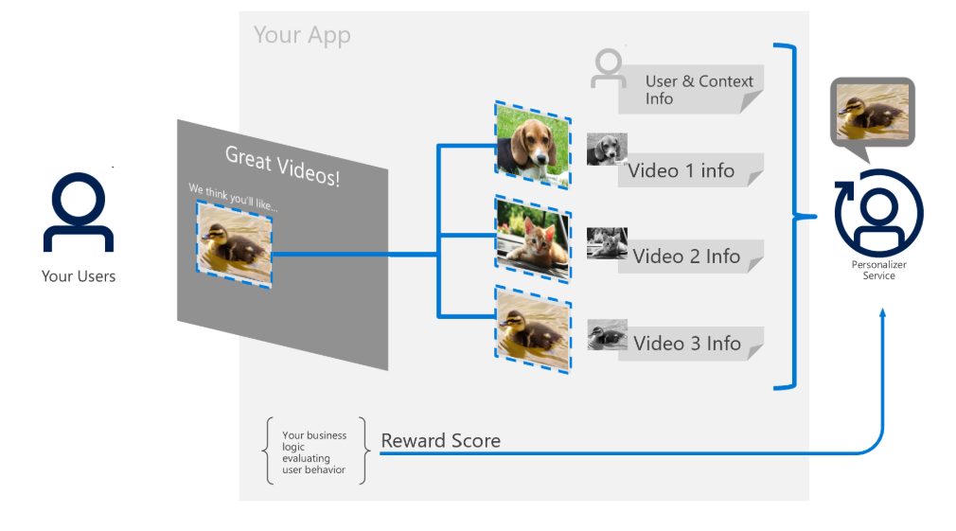
Cognitive Services | Decision Making – Personalizer
Azure Personalizer is a cloud-based API service that allows you to choose the best experience to show to your users, learning from their real-time behavior.
.

Slide 34
Cognitive Services | Decision Making – Personalizer
Demo & Use-cases
.
Production Recommendations In Retail Apps
Video Recommendations in Learning Apps
Reinforcement learning use cases across industries

Slide 35
Debrief About Offline HoL and Challenges

Slide 36
Day 2 closure and Q&A

